Slide 1

Day2-Databricks-Part2

Slide 2
DELTA LAKE AND DATA MANAGEMENT

Slide 3
1️⃣ UI Overview
This typically refers to the Databricks workspace interface, where you manage data and Delta tables.
Key components:
Workspace – Notebooks, folders, repos
Data tab / Catalog – View databases, tables, schema
Compute – Create and manage clusters
Jobs & Workflows – Schedule pipelines
SQL Editor – Run SQL queries on Delta tables
The UI helps manage Delta Lake operations visually.

Slide 4
2️⃣ Delta Lake Overview
Delta Lake is an open-source storage layer built on top of data lakes (like S3, ADLS, GCS).
It provides:
ACID transactions
Schema enforcement
Schema evolution
Time travel
High performance with optimizations
It stores data in Parquet format with a transaction log (_delta_log).

Slide 5
3️⃣ ACID Transactions
Delta Lake ensures:
Atomicity – All operations succeed or fail together
Consistency – Data remains valid after transactions
Isolation – Concurrent writes don’t corrupt data
Durability – Committed data is never lost
This is achieved through the Delta transaction log, enabling reliable streaming + batch processing.

Slide 6
4️⃣ Schema Evolution
Schema Evolution allows modifying table structure without breaking pipelines.
Examples:
Adding new columns
Changing column types (in some cases)
Merging schemas during writes
Options in Spark:
.option("mergeSchema", "true")
It supports gradual schema changes in evolving data sources.

Slide 7
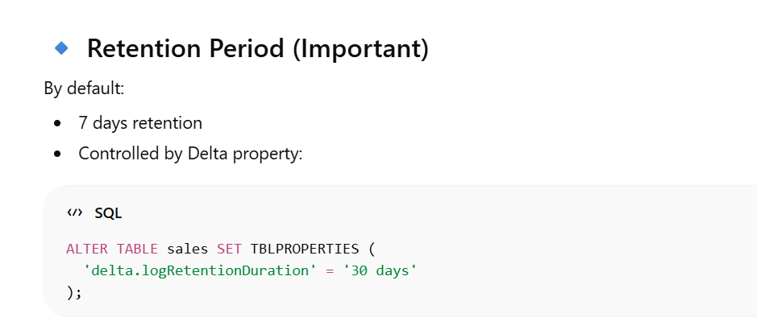
5️⃣ Time Travel
Time Travel allows querying historical versions of a Delta table.
Time Travel in Databricks works on Delta tables. It allows you to query previous versions of a table.
✅ Works with Unity Catalog ✅ Works only for Delta tables
Can:
Query previous versions
Restore deleted data
Audit changes
Example:
SELECT * FROM table VERSION AS OF 5;
Useful for debugging, auditing, and rollback.

Slide 8
6️⃣ Optimization
Optimization improves query performance.
Common techniques:
OPTIMIZE (compaction – reduces small files)
Z-ORDER (cluster data for faster filtering)
VACUUM (remove old files)
Partitioning strategy
Example:
OPTIMIZE sales ZORDER BY (customer_id);

Slide 9
Optimize
Problem:
When you continuously write data (streaming or frequent inserts), many small files are created.
Too many small files = ❌ Slow reads ❌ More metadata overhead ❌ Poor performance
Solution: OPTIMIZE
OPTIMIZE sales;
This:
Combines small files into larger files
Improves read performance
Reduces file count

Slide 10
2️⃣ Z-ORDER (Cluster Data for Faster Filtering)
🔥 Problem:
If you filter frequently on a column: SELECT * FROM sales WHERE customer_id = 101;
Without clustering → full scan With Z-ORDER → faster skipping of irrelevant files
✅ Use Z-ORDER
This:
Physically reorganizes data
Groups similar values together
Improves filtering & join performance
When to Use Z-ORDER?
Use when:
Large tables (100GB+)
Frequent filtering on certain columns
High-cardinality columns (customer_id, order_id)
⚠️ Do NOT overuse on many columns.

Slide 11
3️⃣ VACUUM (Remove Old Files)
Why Needed?
VACUUM permanently deletes old data files from a Delta table that are no longer needed and older than the retention period. It helps reduce storage but removes time travel ability for those versions.
✅ Use VACUUM - VACUUM is a Delta Lake cleanup command.
VACUUM sales;
Default: Removes files older than 7 days
If you vacuum aggressively:
VACUUM sales RETAIN 0 HOURS;
❌ You lose time travel ability permanently
In production:
VACUUM sales RETAIN 168 HOURS; -- 7 days

Slide 12
7️⃣ Data Quality & Validation
Delta Lake supports enforcing data correctness through:
Schema Enforcement (no unexpected columns)
NOT NULL constraints
CHECK constraints
Deduplication
Expectations (in Delta Live Tables)
This ensures clean, reliable data for analytics and ML.

